Slide 1
Complaint Management System
Mahidhar Mannuru

Slide 2
Outline of the presentation
Abstract
Objective and Problem Analysis Introduction
Existing System Proposed System
Modules System Architecture
Result
Conclusions

Slide 3
ABSTRACT
1)By providing this mechanism student complaints are noted and verified by presenting the model of a web based system.
2) By automating the grievance process, the proposed model will improve the relationship between student and management.
3)Grievance system is an online platform of private or public institutions enabling prompt action on any issue raised by the student.
4)This will ensure transparency and students will be more benefitted. Grievance system helps to pursue quick actions for solving the grievance, while maintaining affordability and ease to the users

Slide 4
OBJECTIVES OF CMS
1)To identify the issued faced by the students and users with the manual system
2)Development of the system architecture that fits the needs of the current day scenario problems
3)Development of web-based application for the CMS and Integrating with the data Store..

Slide 5
INTRODUCTION TO CMS
A “Grievance” is a feeling of dissatisfaction whether expressed or not, whether valid or not, arising out of anything that is connected with the organization which a student thinks, or even feels to be unfair or inequitable.Some of the dissatisfaction is based upon genuine causes but some of them are not real and are created by the students only to blame others. This dissatisfaction is called “grievance”. Grievance system is an online platform of private or public institutions enabling prompt actions on any issue raised by them. The cell members deal with all types of grievances, received from students. The implementation of the grievance system will be helpful to address all the grievances in a time-bound manner.

Slide 6
EXISTING SYSTEM
The existing system is completely manual. In order to write the complaint, the student either Visits the related department and registers his complaint in the respective complaint register,which is monitored by the respective Department heads. Existing system requires manual process (i.e.,sending grievances from lower level to critical level requires manual process.)
DISADVANTAGES OF EXISTING SYSTEM:
Grievance paper might be replaced.
Modifications can be done.
Management might neglect the complaint raised by the student.

Slide 7
PROPOSED SYSTEM
The idea is to automate the entire complaint process.Grievance can be lodged based on the level (i.e.,university, college, course and department) andalso based on the category (i.e., transportation,scholarship, lecture time table etc…).Students can able to track the grievance once the complaint has been registered.Students and cell members are provided with achat box where they can discuss regarding the grievance.Student can provide any document as a proof,which makes the complaint strong.Cell Member can track the pending and completed grievances.

Slide 8
ADVANTAGES OF PROPOSED SYSTEM
Less paper work.
Security and satisfaction of the student.
Increased accuracy and reliability
Easy maintenance of data.

Slide 9
SOFWARE COMPONENTS
Frontend:HTML5,CSS,JAVASCRIPT,BOOTSTRAP
Backend:PHP,MYSQL
SoftwareTools:VScode,Xampp,Live Server Modules
WebBrowser:Mozilla,FireFOX

Slide 10
HARDWARE COMPONENTS
Processor: Minimum 1 GHz; Recommended 2GHz or more
Ethernet connection (LAN) OR a wireless adapter (Wi-Fi)
Hard Drive: Minimum 32 GB; Recommended 64 GB or more
Memory (RAM): Minimum 1 GB; Recommended 4 GB or above

Slide 11
MODULES
1)ADMIN:Login,viewcomplaint,update or respond,create/update faculty
2)FACULTY:login,viewcomplaint,update or respond
3)Student/user:Login,raise a complaint,check their complaint

Slide 12
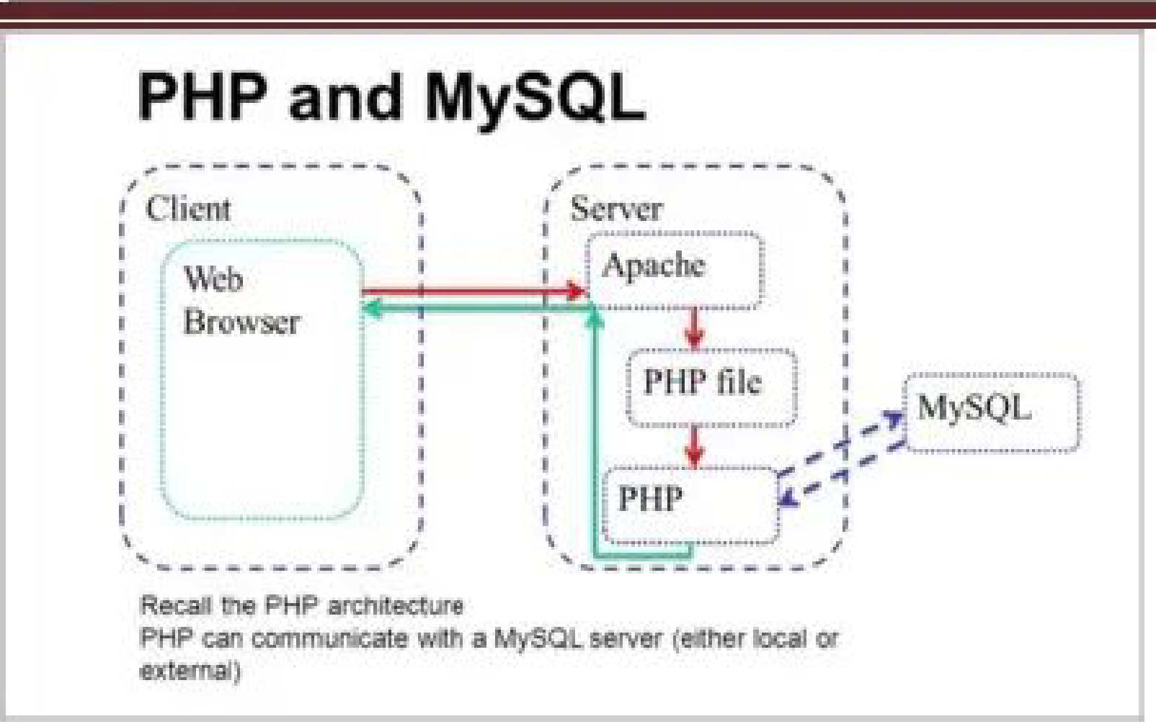
SYSTEM ARCHITECTURE

Slide 13
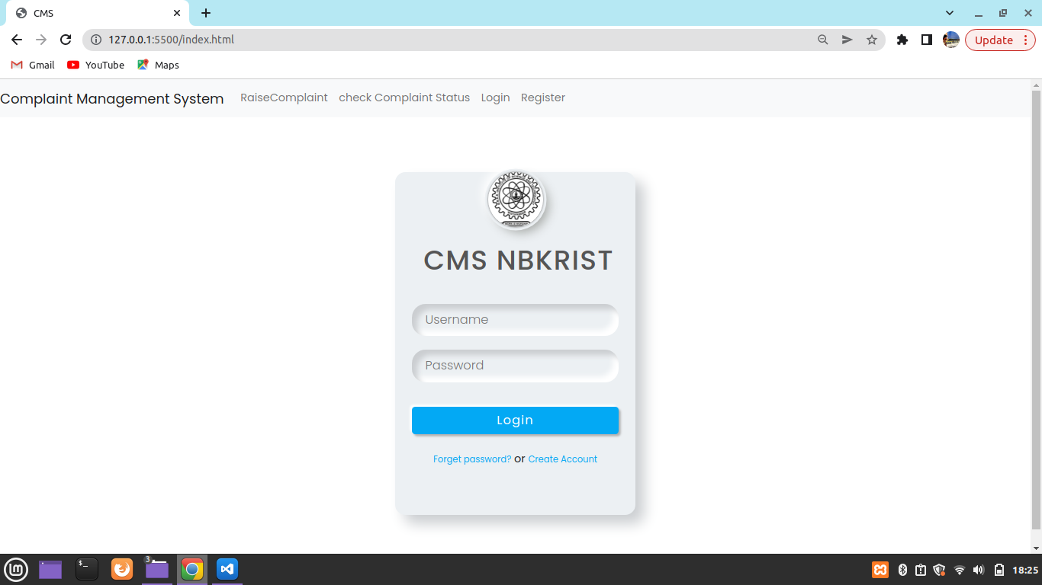
RESULTS: LOGIN PAGE

Slide 14
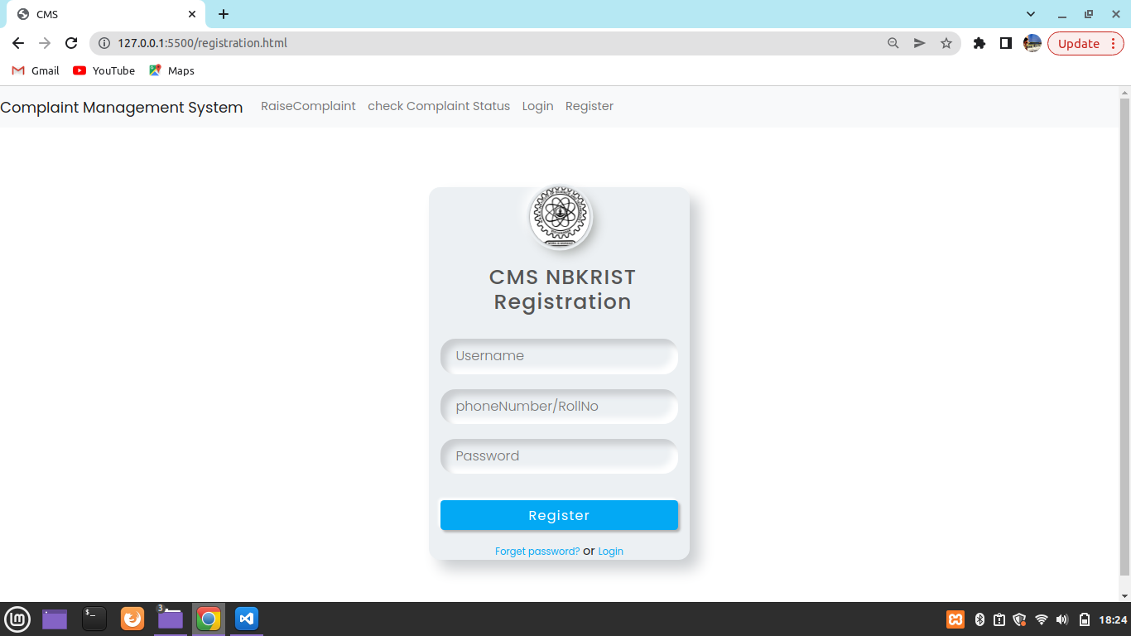
REGISTRATION

Slide 15
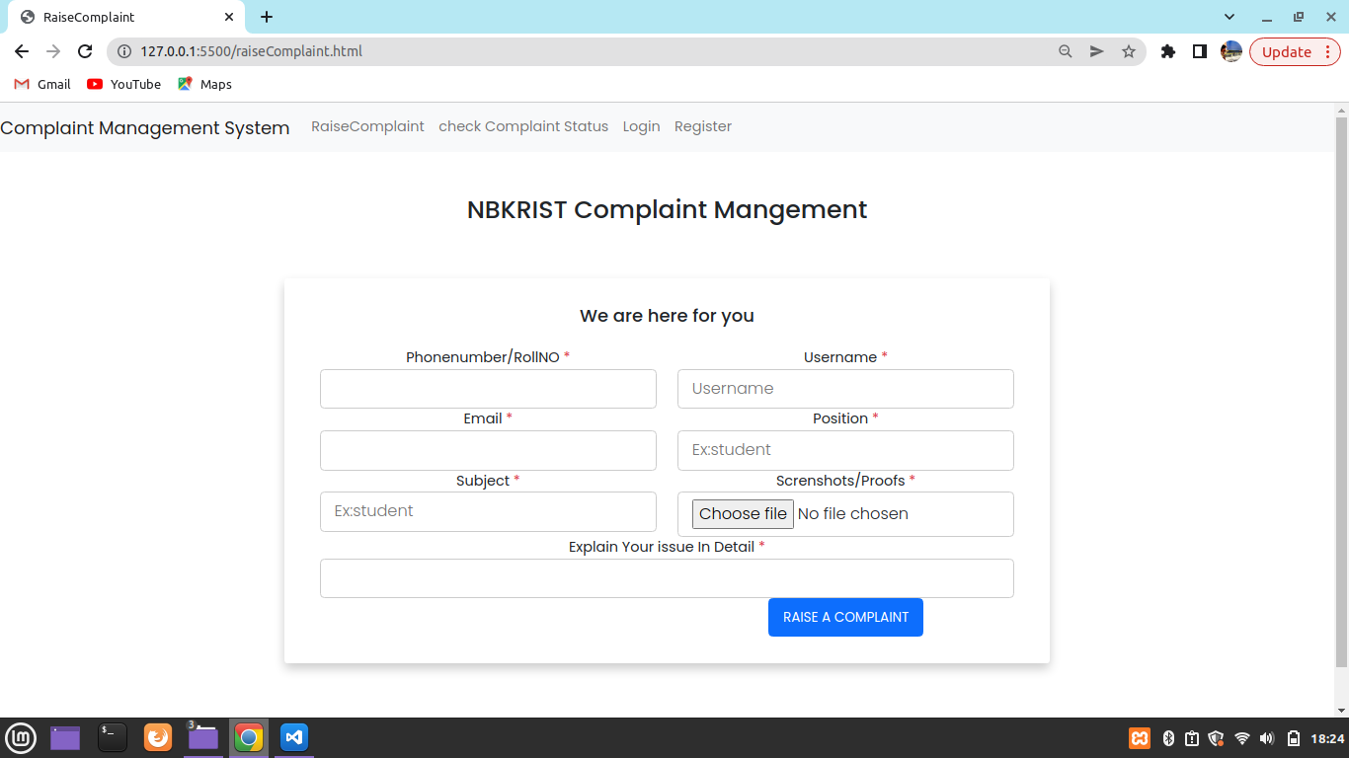
RAISE A COMPLAINT

Slide 16
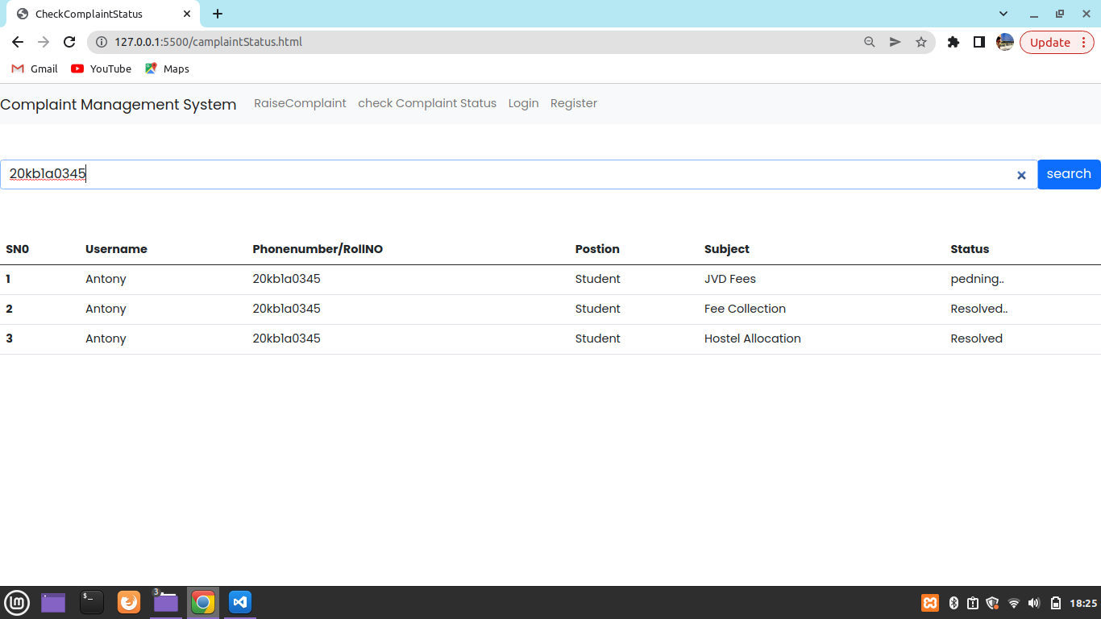
VIEW A COMPLAINT

Slide 17
CONCLUSION
Designed in order to reduce the burden of maintaining bulk of records of all students grievance details of whostudy in Educational Institution. Maintaining the project and database is also easy and manageable. The fact that there are hardly such systems prevailing curtailing to the complaint redressed for students enrolled in numerous organizations. This project has demonstrated a proposedGrievance system for the grievance redressed of students covering various domains of complaints which could be lodged easily and thus leading to easy and sure solutions to the problems being faced by a student on a regular basis.Inserting, Retrieving, Updating the details of all users are easy. “Finally, online student grievance system comes out as better,quicker, simpler management analyser”

Slide 18
THANK YOU

